Slide 1
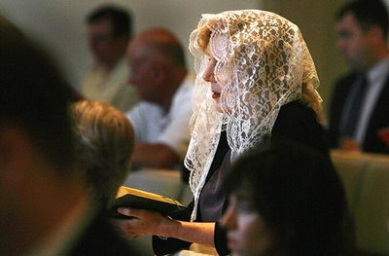
Veils, Tales, & Females
1 Corinthians 11:2-16
Dr. Rick Griffith • Crossroads International Church Singapore
cicfamily.com & BibleStudyDownloads.org
Notes:
1

Slide 2
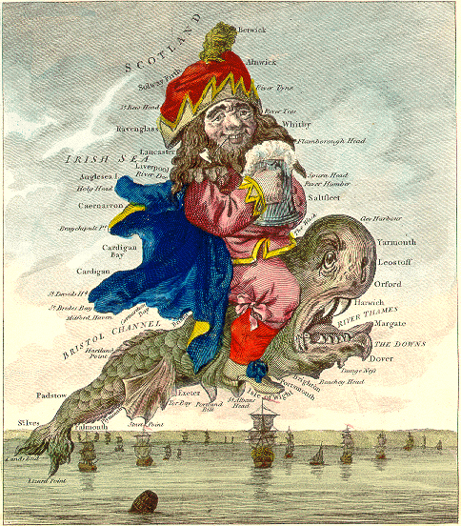

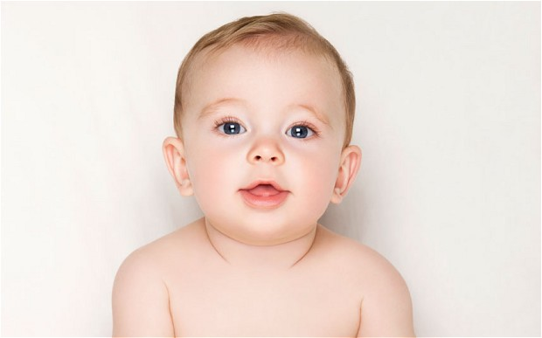
England, 1998

Slide 3
Black

Slide 4
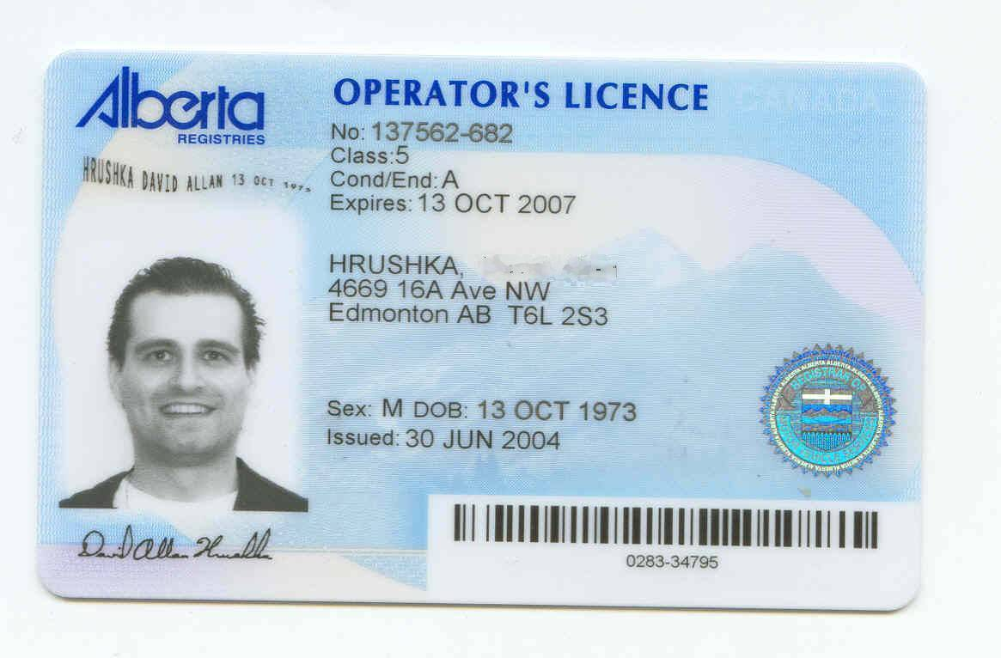

Black
F
14 APR 1956

Slide 5
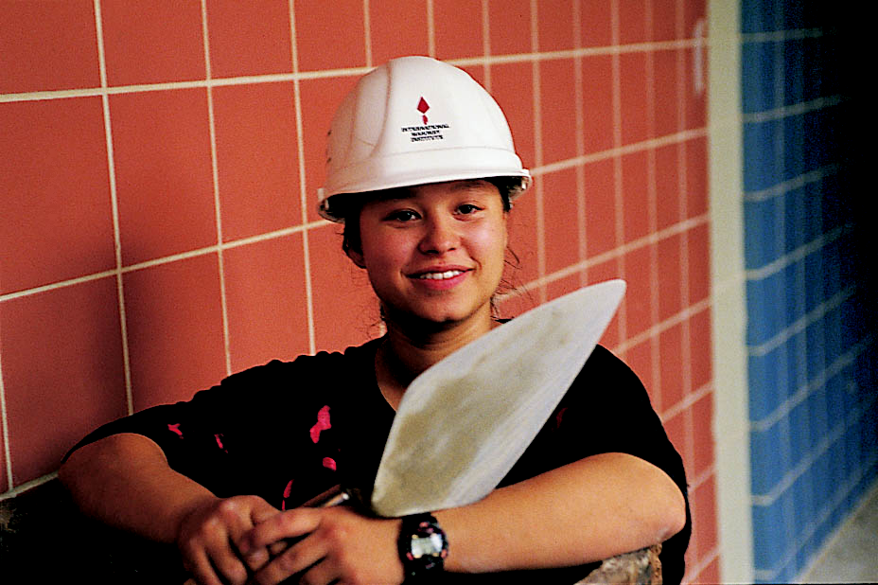
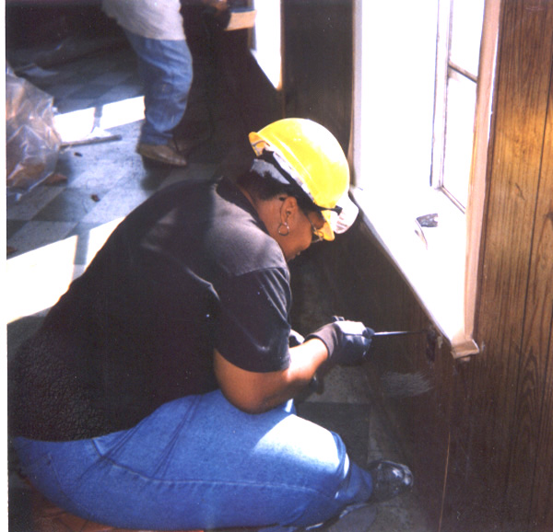
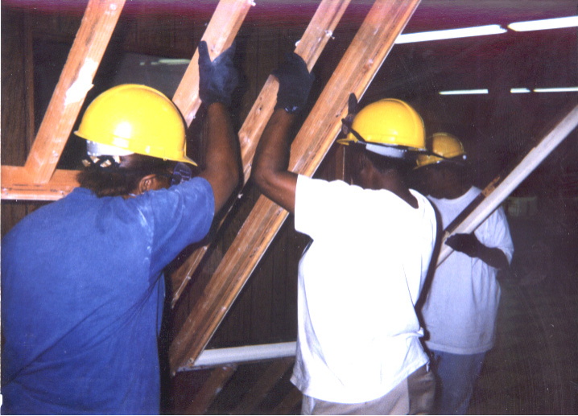

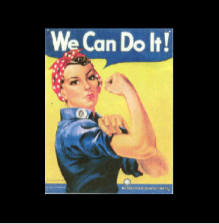
WOW
Bricklayer
(Wider Opportunities for Women)
Electrician
Carpenter
Coach
Notes:
5
www.work4women.org/multimedia/ photos.cfm

Slide 6
My, how language has changed…
Mankind
Humankind
Stewardess
Flight Attendant
Fireman
Fire Fighter
The Past
The Present
Policeman
Police Person
Boss
Bosset

Slide 7

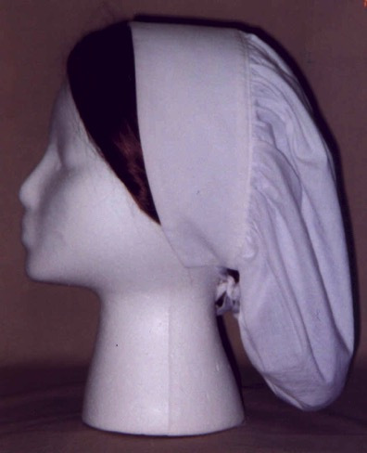
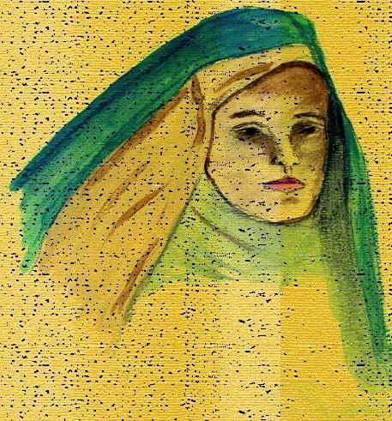

Who wore head coverings?
?
ASSYRIA
ISRAEL
Corinth

Slide 8

1 Corinthians 11:2 NLT
²I am so glad that you always keep me in your thoughts, and that you are following the teachings I passed on to you.

Slide 9
Black

Slide 10
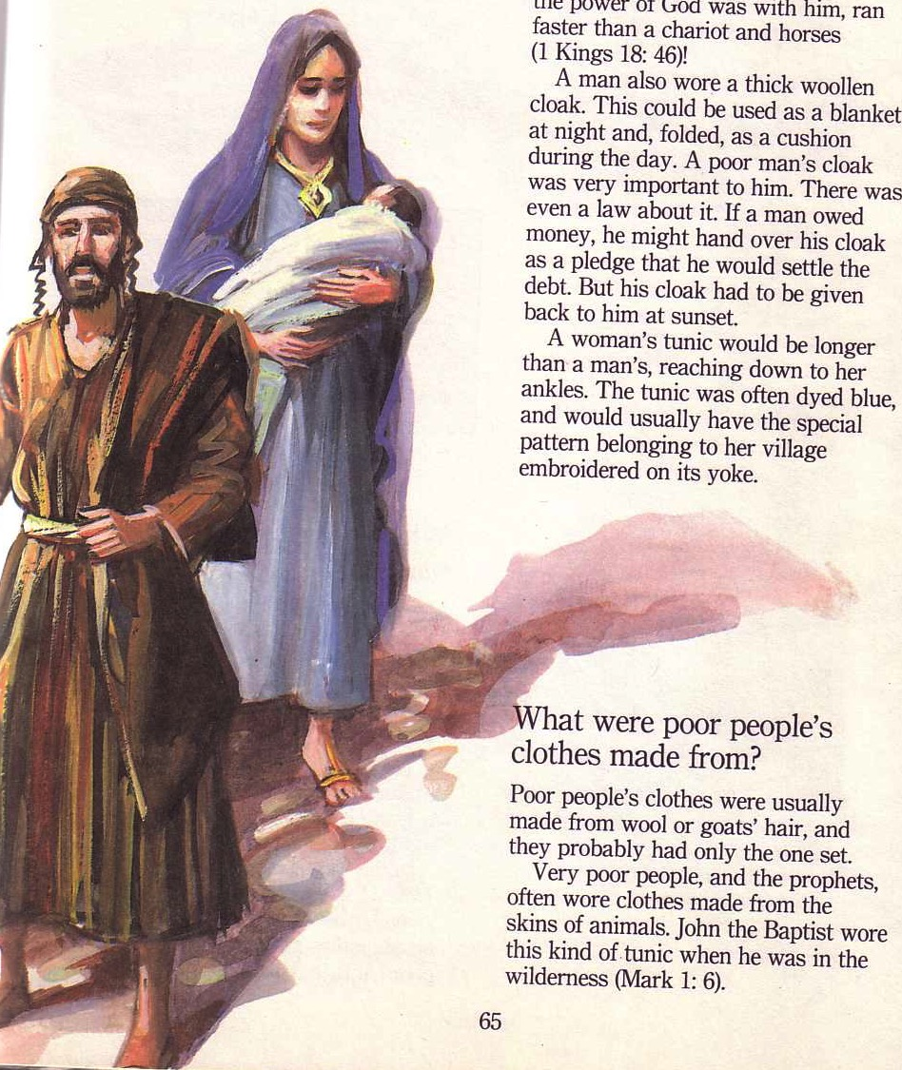
Towards the Main Idea…
Men and women are equal but different--so the church must maintain these sexual distinctions.
But why?
1 Corinthians 11

Slide 11
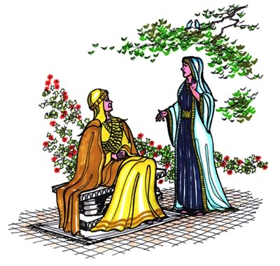
I. Resisting sex distinctions shames our authorities.
Why maintain distinctions?

Slide 12
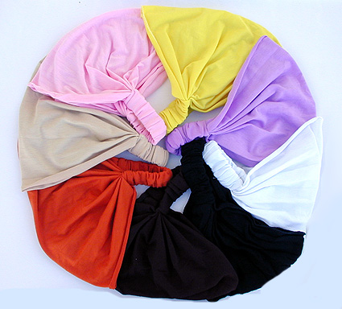
Why maintain distinctions?
A. Wrong use of a head covering at the church of Corinth shamed their authorities
(3-6).

Slide 13
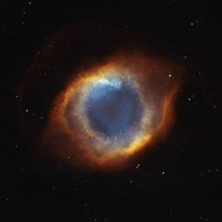
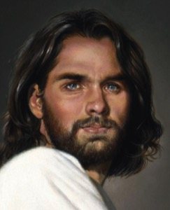


God's Authority Structure
God
Christ
The head of every man is Christ, the head of woman is man, and the head of Christ is God
(1 Cor. 11:3 NLT)
Husband
Wife

Slide 14
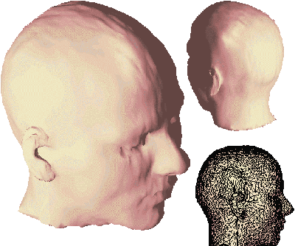
What does “head” mean?
Notes:
14

Slide 15

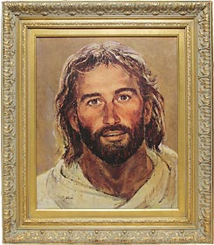
What does “head” mean?
“source”?
“authority”?
Notes:
15

Slide 16
Black
Notes:
16

Slide 17
God's Authority Structure
God
Christ
The head of every man is Christ, the head of woman is man, and the head of Christ is God
(1 Cor. 11:3 NLT)
Husband
Wife
Notes:
17

Slide 18
1 Corinthians 11:4 NLT
⁴A man dishonors his head if he covers his head while praying or prophesying.
Notes:
18

Slide 19
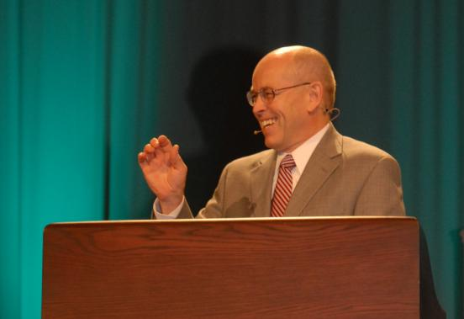
Wayne Grudem's
Definition of Prophecy
“telling something that God has spontaneously brought to mind”
“Why Christians Can Still Prophesy” Christianity Today (16 Sept 1988), 29

Slide 20

What is Prophecy?
“knowing this first of all, that no prophecy of Scripture comes from someone's own interpretation. For no prophecy was ever produced by the will of man, but men spoke from God as they were carried along by the Holy Spirit”
2 Peter 1:20-21 (ESV)

Slide 21
1 Corinthians 11:4 NLT
⁴A man dishonors his head if he covers his head while praying or prophesying.
Notes:
21

Slide 22
1 Corinthians 11:5-6 NLT
⁵But a woman dishonors her head if she prays or prophesies without a covering on her head, for this is the same as shaving her head. ⁶Yes, if she refuses to wear a head covering, she should cut off all her hair! But since it is shameful for a woman to have her hair cut or her head shaved, she should wear a covering.
Notes:
22

Slide 23
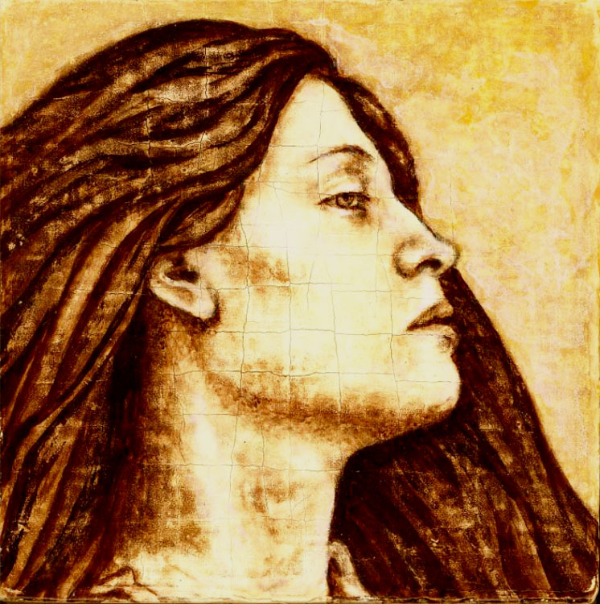
Flowing Hair
Notes:
23

Slide 24
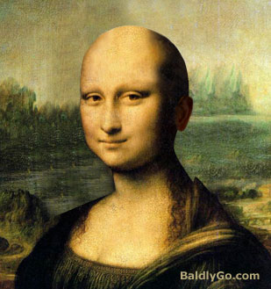
Bald Mona Lisa
Notes:
24

Slide 25
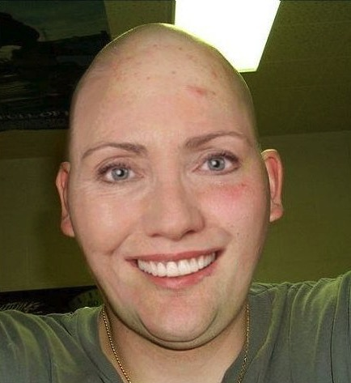
Bald Hair
Notes:
25

Slide 26
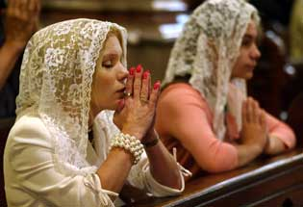
Should women worship with the veil?
Notes:
26

Slide 27

Veils at a wedding are beautiful…
Notes:
27

Slide 28
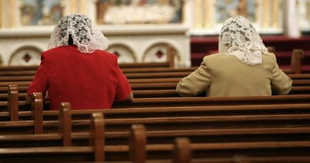
In most societies today, head coverings send the wrong signal––that we are out of touch with societal convention
Notes:
28

Slide 29
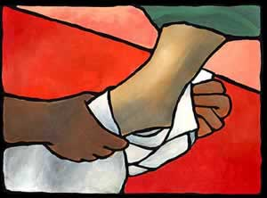
B. Today we must honor our authorities during worship.
Men
Notes:
29

Slide 30

Michael Jackson
Notes:
30

Slide 31
Black
Notes:
31

Slide 32
B. Today we must honor our authorities during worship.
Men
Women
Notes:
32

Slide 33


1 Timothy 2:11-15
¹¹A woman should learn in quietness and full submission. ¹²I do not permit a woman to teach or to have authority over a man; she must be silent.
¹³For Adam was formed first, then Eve. ¹⁴And Adam was not the one deceived; it was the woman who was deceived and became a sinner. ¹⁵But women {Gr. she} will be saved {or restored} through childbearing-- if they continue in faith, love and holiness with propriety.

Slide 34
B. Today we must honor our authorities during worship.
Men
Women
All
Notes:
34

Slide 35
I. Resisting sex distinctions shames our authorities.
Why maintain distinctions?

Slide 36

II. A wife should let her husband lead due to the creation order
Why maintain distinctions?

Slide 37
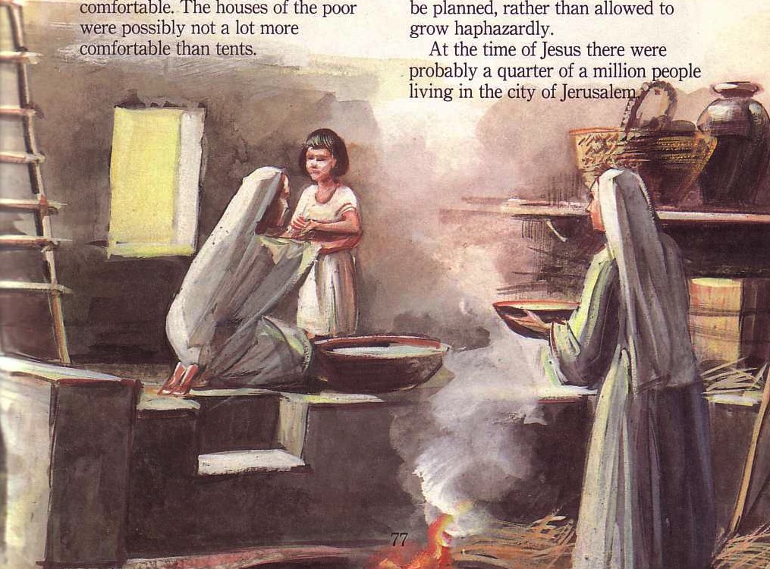
A. A wife's head covering at Corinth showed the husband's leadership since creation (7-12)

Slide 38
1 Corinthians 11:7 NLT
⁷A man should not wear anything on his head when worshiping, for man is made in God's image and reflects God's glory. And woman reflects man's glory.
Notes:
38

Slide 39

Equality of Sexes
God's Creation…Day 6
So God created man in his own image
in the image of God he created him
male and female he created them
(Gen 1:27).

Slide 40
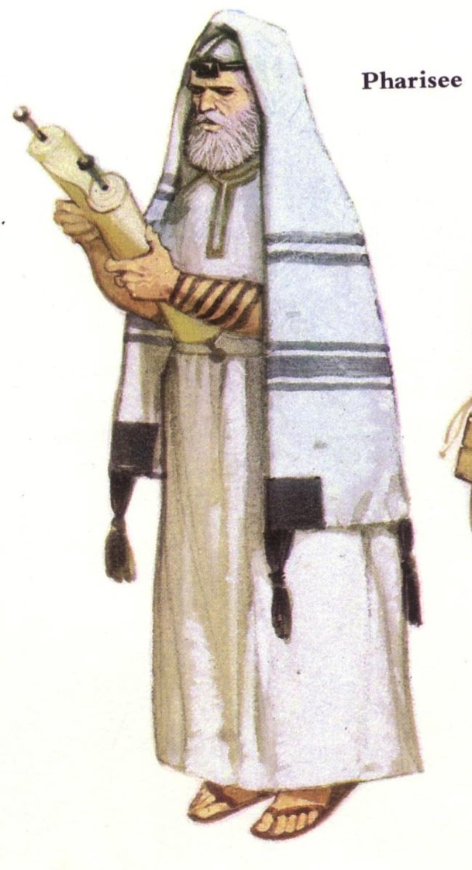

Did Jewish men cover their heads during prayer in NT times?

Slide 41
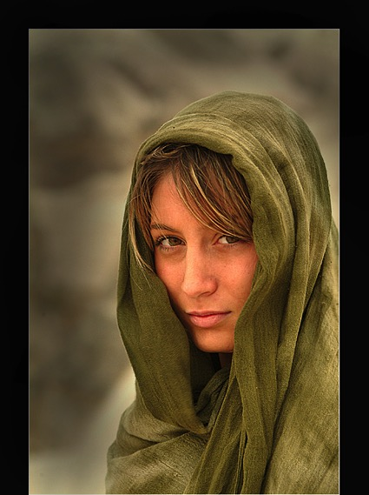
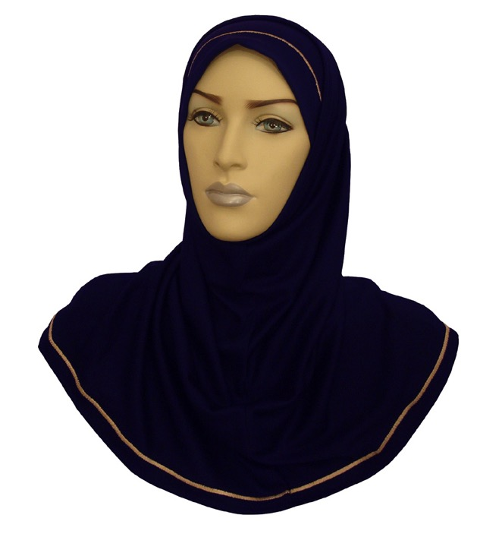
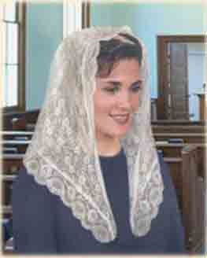
Women in Corinth were to pray with a head covering because husbands have always led their wives (8-10)
Notes:
41

Slide 42
1 Corinthians 11:8-10 NLT
⁸For the first man didn't come from woman, but the first woman came from man. ⁹And man was not made for woman, but woman was made for man. ¹⁰For this reason, and because the angels are watching, a woman should wear a covering on her head to show she is under authority.
Notes:
42

Slide 43
1 Corinthians 11:11-12 NLT
¹¹But among the Lord's people, women are not independent of men, and men are not independent of women. ¹²For although the first woman came from man, every other man was born from a woman, and everything comes from God.
Notes:
43

Slide 44
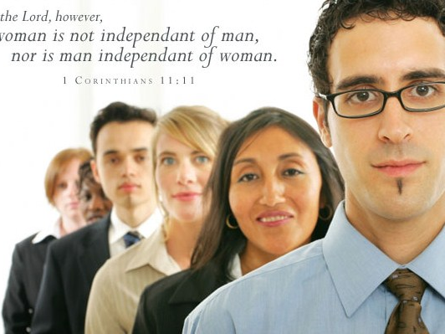
In the Lord, however, woman is not independent of man, nor is man independent of woman.
1 Corinthians 11:11
Notes:
44

Slide 45
1 Corinthians 11:11-12 NLT
¹¹But among the Lord's people, women are not independent of men, and men are not independent of women. ¹²For although the first woman came from man, every other man was born from a woman, and everything comes from God.
Notes:
45

Slide 46

B. Wives today must respect their husband's leadership.

Slide 47
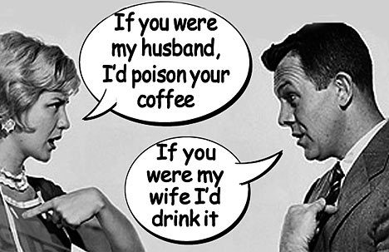
Wife, respect your husband.
Husband, love your wife!
Notes:
47

Slide 48
Black
Notes:
48

Slide 49
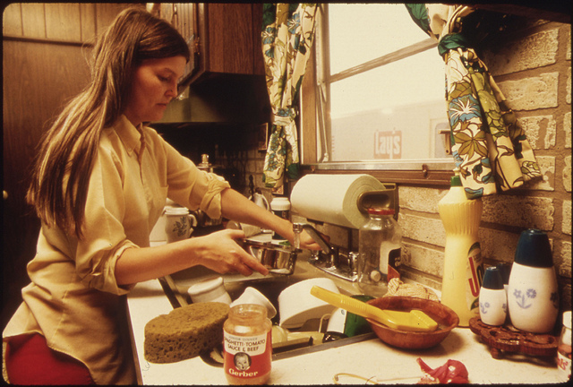
"Workers at home" (Titus 2:4-5 NLT)
These older women must train the younger women to love their husbands and their children, ⁵to live wisely and be pure, to work in their homes, to do good, and to be submissive to their husbands. Then they will not bring shame on the word of God.

Slide 50
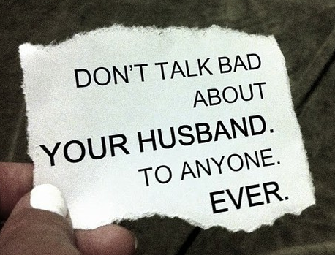
"Submit to husband" (Titus 2:4-5 NLT)
These older women must train the younger women to love their husbands and their children, ⁵to live wisely and be pure, to work in their homes, to do good, and to be submissive to their husbands. Then they will not bring shame on the word of God.
Husbands must not talk bad about their wives either!

Slide 51

III. Don't hinder your witness by blurring the sexes
Why maintain distinctions?
Male or female?

Slide 52
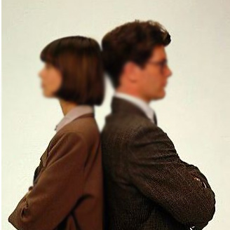
Don't blur proper roles of…
Society (13)
Notes:
52

Slide 53
1 Corinthians 11:13 NLT
¹³Judge for yourselves. Is it right for a woman to pray to God in public without covering her head?
Notes:
53

Slide 54
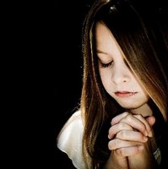
Prayer with head uncovered
Notes:
54

Slide 55
Don't blur proper roles of…
Society (13)
Nature (14-15)
Notes:
55

Slide 56
1 Corinthians 11:14-15 NLT
¹⁴Isn't it obvious that it's disgraceful for a man to have long hair? ¹⁵And isn't long hair a woman's pride and joy? For it has been given to her as a covering.
Notes:
56

Slide 57
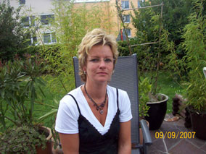



Quellendorf, Germany
Mr. Michaela Lindner
Mr. Norbert Lindner
Notes:
57

Slide 58

Look your part
Notes:
58

Slide 59
Don't blur proper roles of…
Society (13)
Nature (14-15)
Churches (16)
Notes:
59

Slide 60
1 Corinthians 11:16 NLT
¹⁶But if anyone wants to argue about this, I simply say that we have no other custom than this, and neither do God's other churches.
Notes:
60

Slide 61
Black
Notes:
61

Slide 62
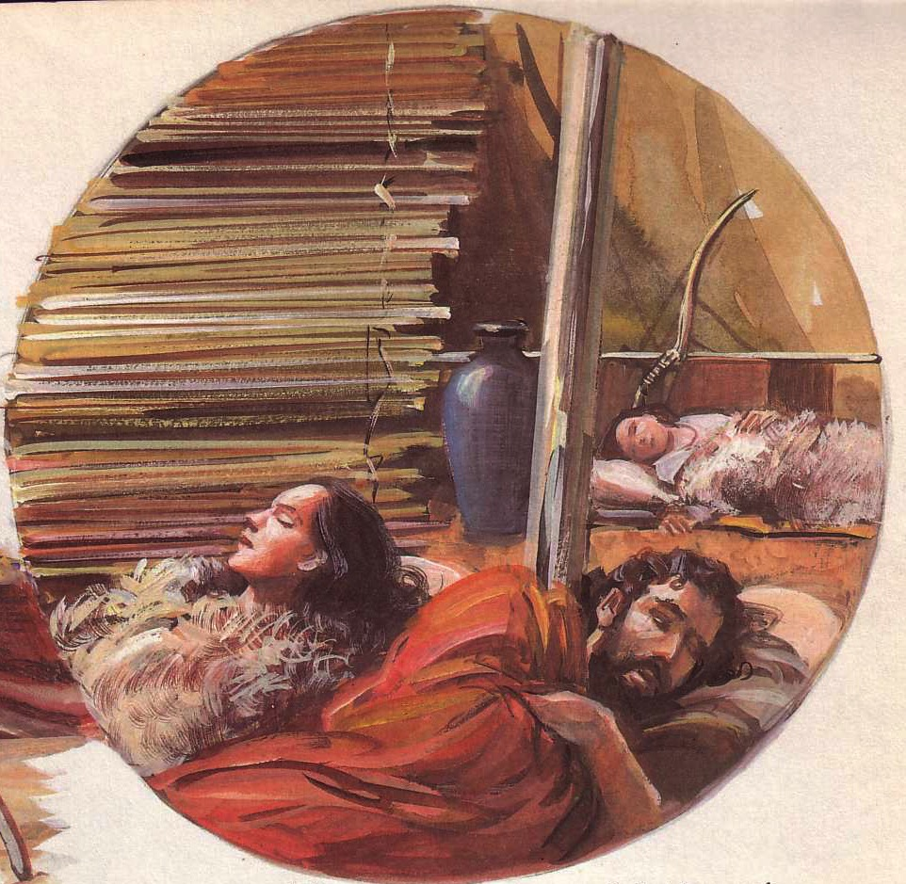
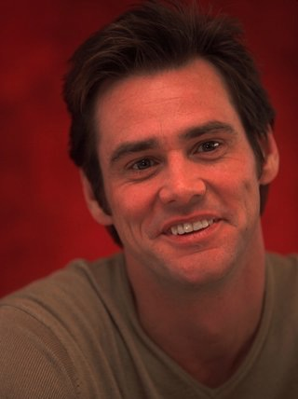
It can be better!
“So many people expect that fairy tale where everyone is going to be together forever, but I don't subscribe to that. I'd love for it to happen, but I think 10 years with someone is enough.”
--Twice divorced actor Jim Carrey
The Internet Movie Database
(www.imdb.com/news/wenn/2004-04-02)
Notes:
62
Brown's views of “free sex” finds a welcome audience in western society that has largely abandoned the marriage institution. England even has more unmarried living partners than it has married couples.

Slide 63
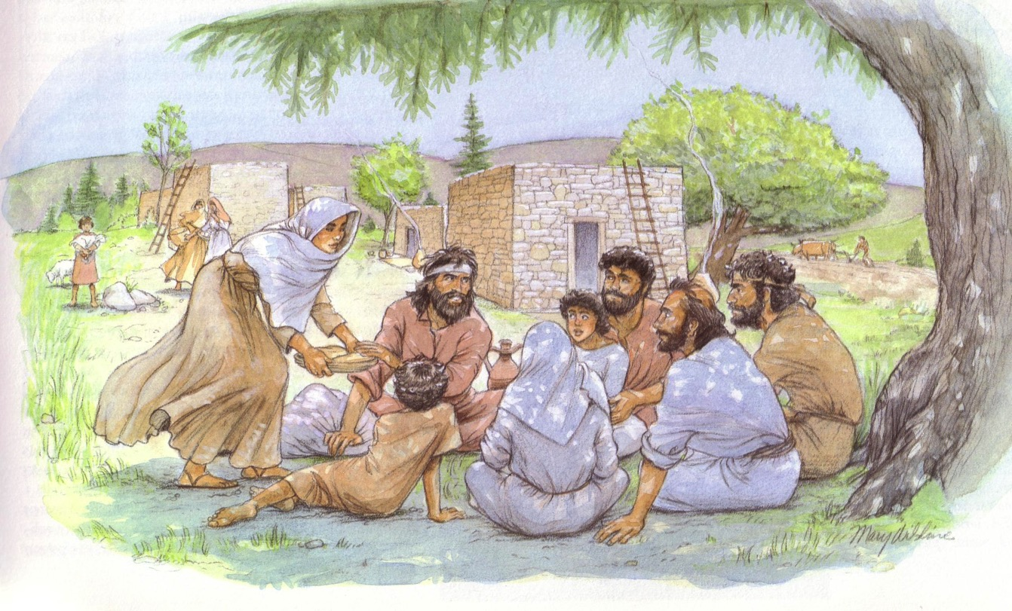
Don't confuse society into thinking that husbands shouldn't lead their wives (Main Idea)
Notes:
63
Brown's views of “free sex” finds a welcome audience in western society that has largely abandoned the marriage institution. England even has more unmarried living partners than it has married couples.

Slide 64
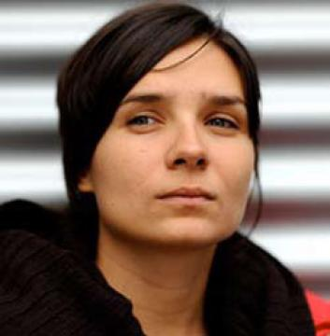
Why should husbands lead?
Confusing sex roles shames our authorities (2-6)
An unsubmissive wife fights God's creation order (7-12)
Blurring the sexes hinders our witness (13-16)
Notes:
64
Brown's views of “free sex” finds a welcome audience in western society that has largely abandoned the marriage institution. England even has more unmarried living partners than it has married couples.

Slide 65
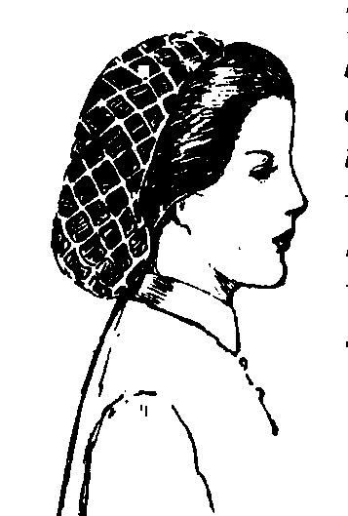
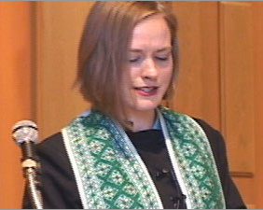
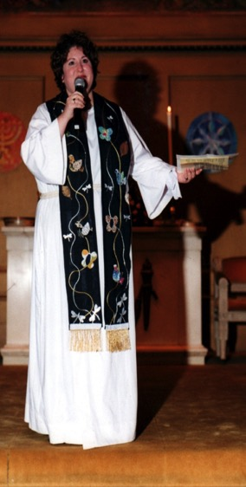
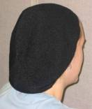
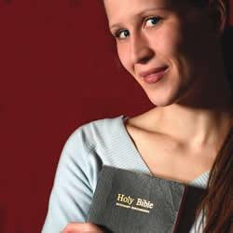
What should you wives do?
“Strenuously avoid whatever forms of dress or grooming [that] communicate to the non-Christian world sexual misconduct or idolatrous worship” (Blomberg, 215)

Slide 66

Men Must Do Right
Notes:
66

Slide 67
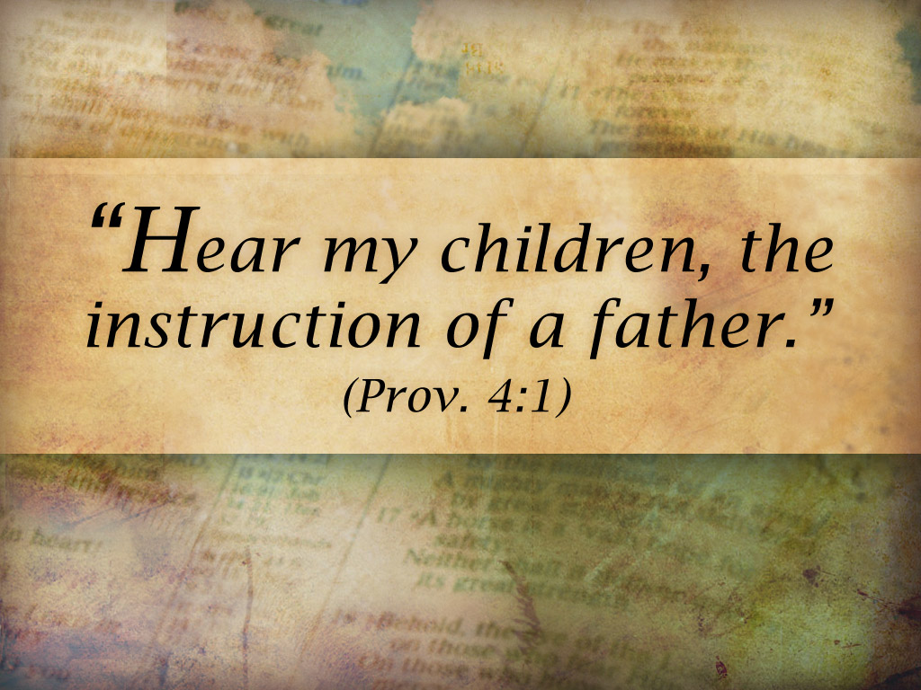
Fathers teach

Slide 68

What should you others do?
Don't Demand Your Rights

Slide 69
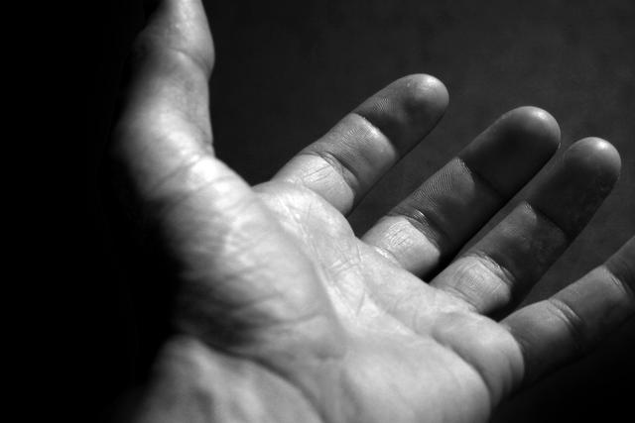
Give up your rights to…
• sue another believer (1 Cor. 6)
• marriage or singleness (1 Cor. 7)
• eat food offered to idols (1 Cor. 8)
• practices hindering your witness (1 Cor. 9)
• join pagan celebrations (1 Cor. 10)
• deny God's authority structure (1 Cor. 11)

Slide 70
Black
Notes:
70

Slide 71


NT Preaching link at BibleStudyDownloads.org
Get this presentation and script for free!
Notes:
NT Preaching (np)

